Slide 1
Battle of the Neighborhoods
Final Presentation

Slide 2
Life School Phuket
Small international alternative school for expat kids and mixed kids
5 years in operation
Looking to expand and open 4-5 new school in next decade
Owner is avid surfer and wants to open new school near great waves
Can we use k-means clustering to narrow a list of 50 spots down?

Slide 3
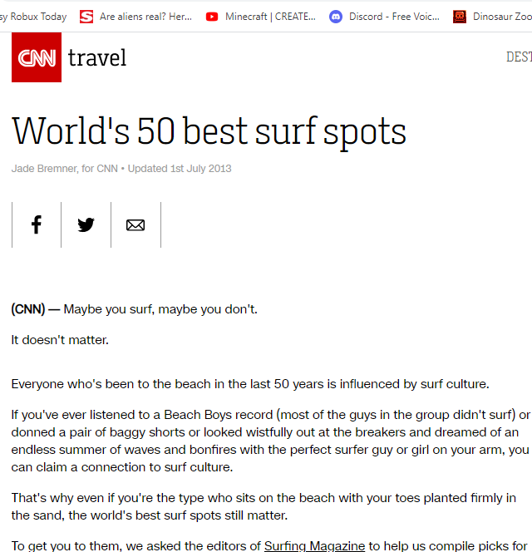

Data
In 2013 CNN published an article with their 50 top surf spots
Phuket was included in the list
Foursquare venue data was collected for each spot

Slide 4
Methodology
Webscraping with Beautiful Soup
Jupyter Notebook in IBM Watson Studio
GPS data manually scraped from Google to a CSV file
Foursquare API to obtain venue data
K-means clustering to create 5 clusters of spots
Division of results into developed and developing economies

Slide 5
Results
11 Surf Spots in the cluster including Phuket
After removal of developed economies the remaining surf spots were:
Puerto Escondido, Mexico
Montanita, Ecuador
Hainan Island, China
Arugam Bay, Sri Lanka
Bali, the top choice prior, did not make the same cluster as Phuket

Slide 6
Discussion
Arugam Bay is probably the most likely candidate from the Cluster
The clustering exercise will be redone with other data including factors I believe are important
Cost of doing business
Size of expat community
Number of tourist arrivals
This exercise will be redone changing from Uluwatu, Bali, to Kuta

